Slide 1
École Morden Middle School We need your help!

Slide 2
We are hoping to create our very own school mascot! We need help with the design.

Slide 3
Take a look at these mascots! It may give you some ideas.

Slide 4
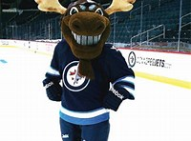
Winnipeg Jets Mascot

Slide 5
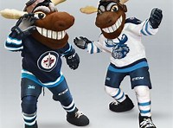
Mickey Moose

Slide 6
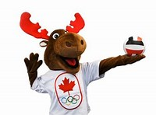
Canadian Olympic Mascot

Slide 7
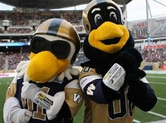
Winnipeg Blue Bombers

Slide 8
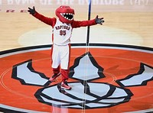
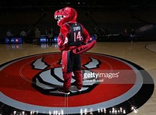
Toronto Raptors

Slide 9
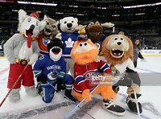
Canadian NHL Mascots

Slide 10
Please complete the École Morden Middle School Mascot Survey!

